Slide 1


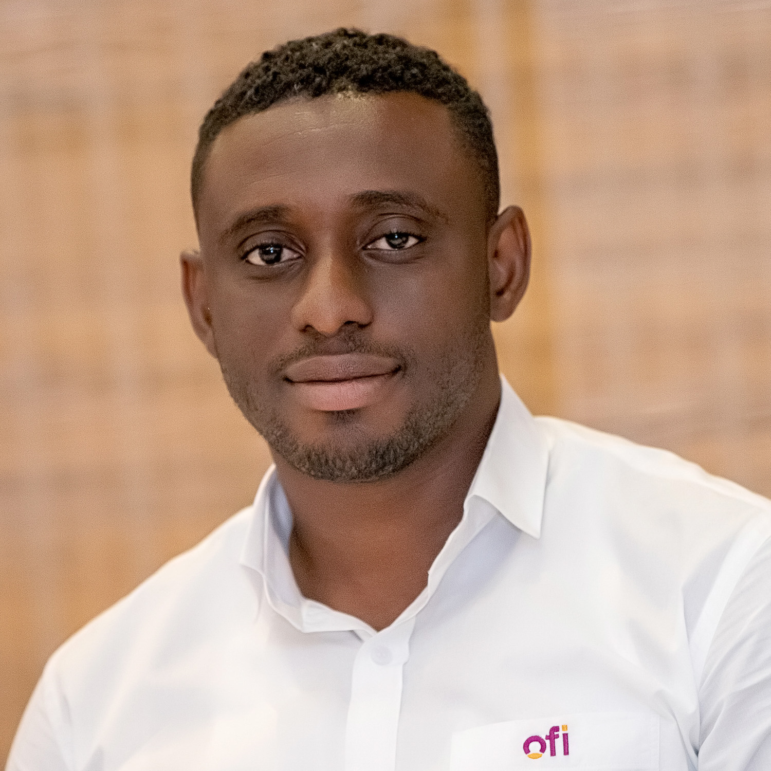
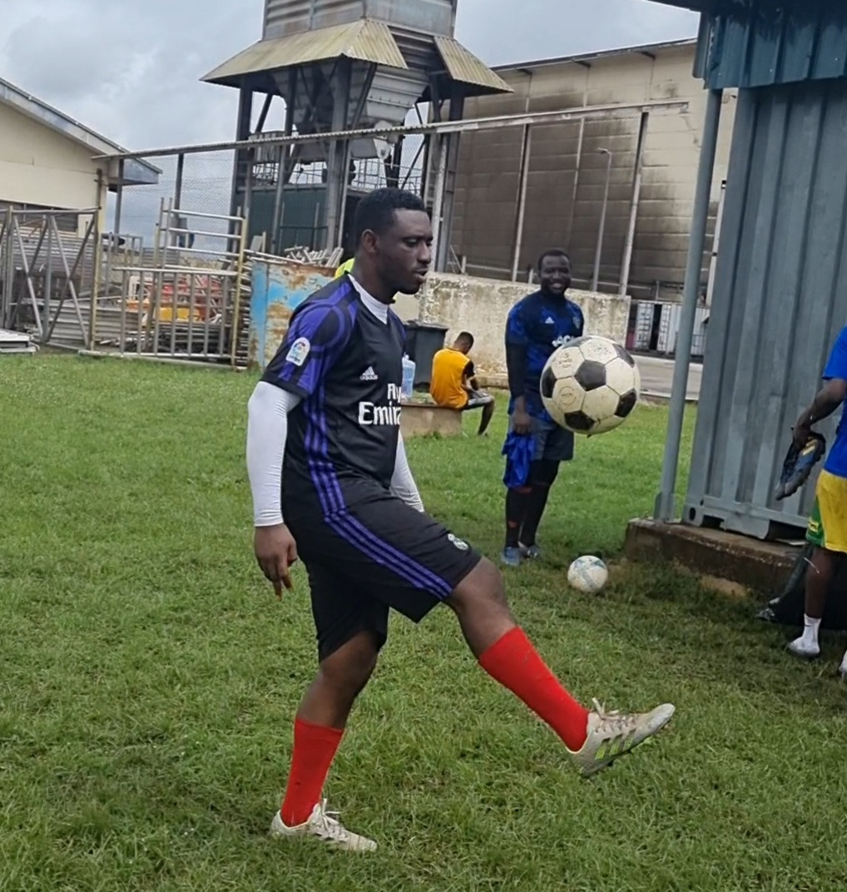
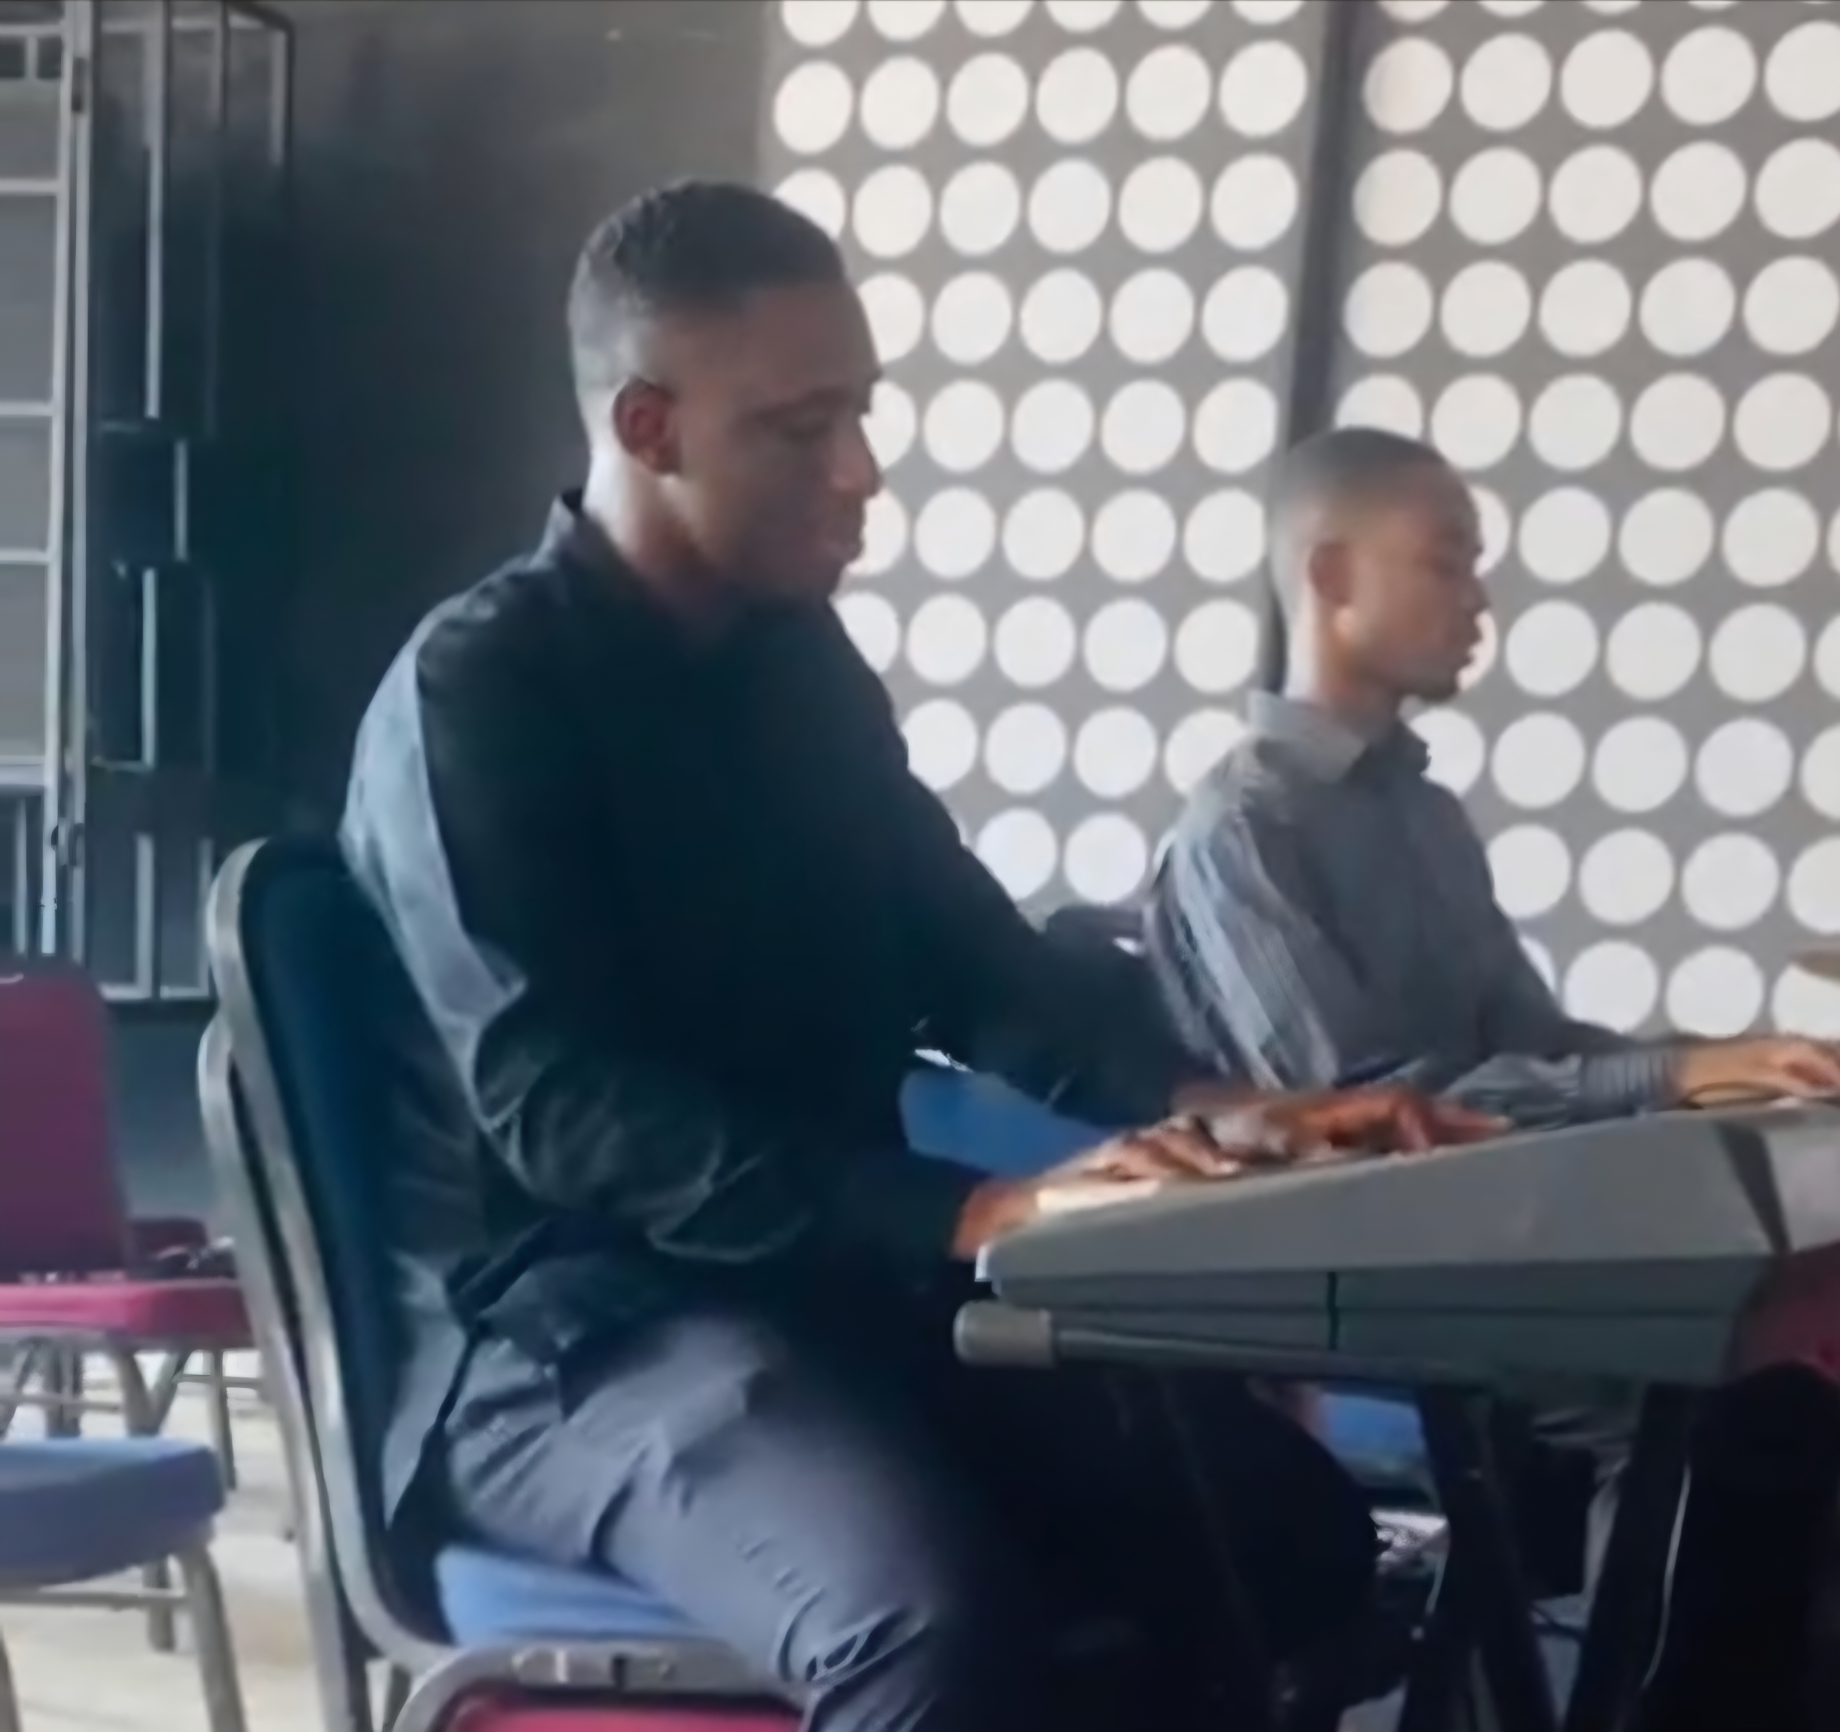
Getting to Know Me
Work
Personal
My role
Projects Manager
Significant others / family members / furry friends in my life
Wife – Suzzy Friend 1 - Kwame
Mum - Mama Emma Friend 2 - Isaac
Tenure in ofi/Olam
Sept 2012 to Present [13yrs]
How I enjoy spending my free time
Soccer – Field or on PlayStation
On the Piano
Previous companies I have worked at
From School as a Teaching Assistant
My favorite / comfort food
Rice with Garden Egg Stew
Why I joined ofi/Olam and what keeps me here?
Initially, I was eager to apply my knowledge and skills in a real-world setting, but I’ve stayed for the rewarding challenges and the continuous growth.
My favorite song
We are the World – Michael Jackson
David AMPONSAH
‘Dave’
A few fun facts about me
I know Kumasi better than locals after 13 years of exploring with Google Maps – Now I’m the groups human GPS!
I’m also a fast swimmer…so fast that during a demo deep dive with my instructor, I forgot to swim back up and had to be rescued. Turns out, enthusiasm > survival instincts. 😂
This is me outside work, doing stuff I enjoy in my life …

